Slide 1
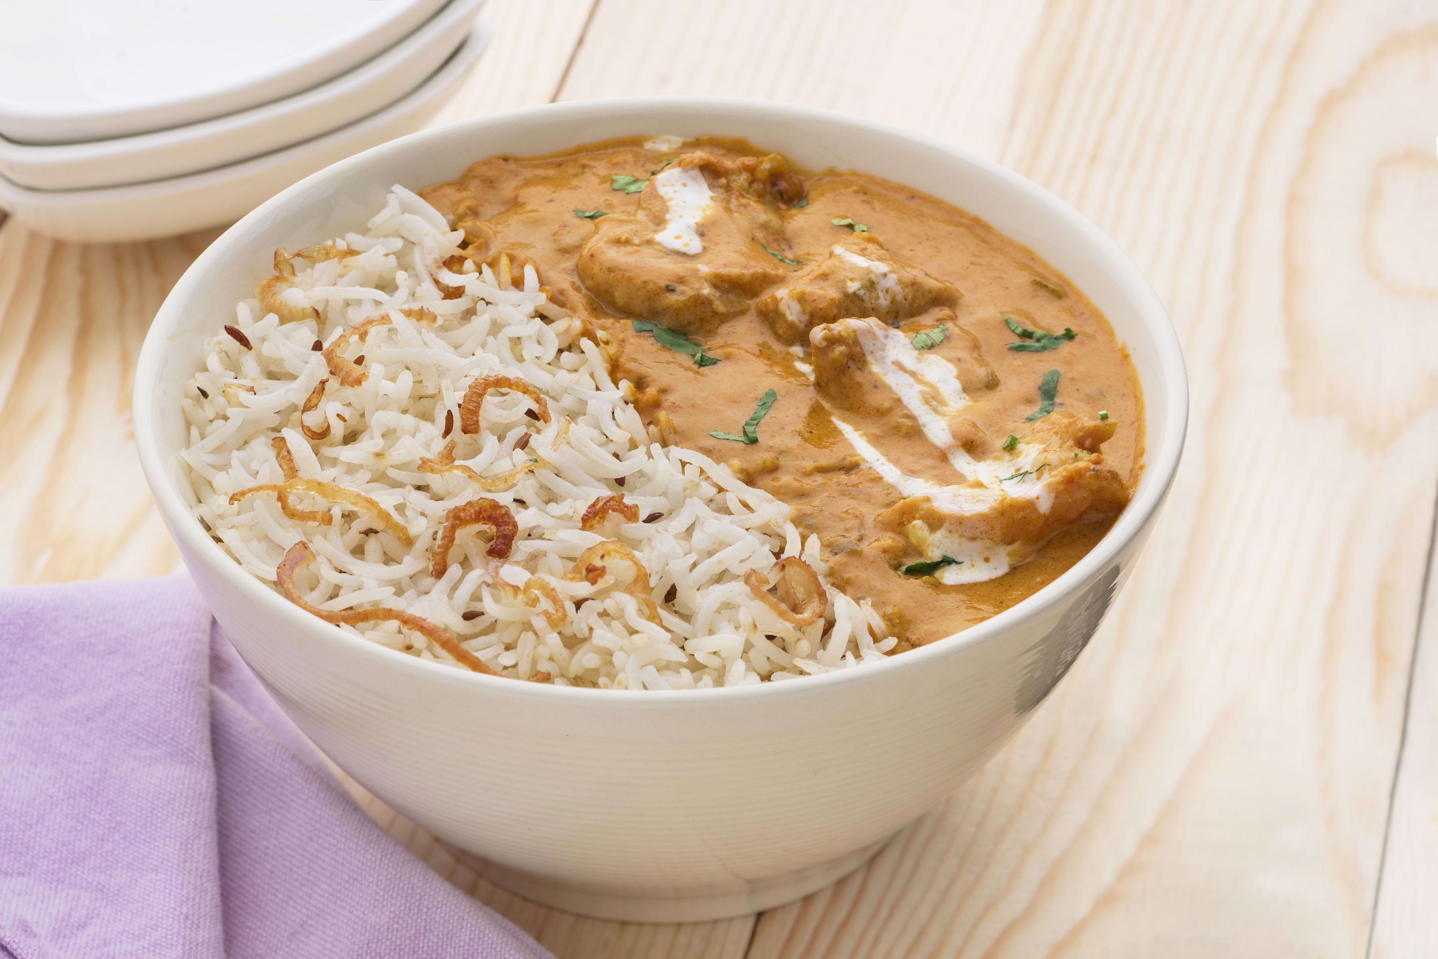
Brute force
“
The Bowl
”
Food delivery system application

Slide 2
Overview:
Introduction
Team Members Roles and Responsibilities
Core Functionalities
Implementation Details
Gantt chart
Limitations and Challenges

Slide 3
Introduction:
The primary motivation of ‘Food delivery system’ is to provide the users with an online booking service which serves food at their door step.
This system helps the users to conveniently order the rice bowls as per their choice with out being in a line and wasting their precious time .

Slide 4
Team members responsibilities:
Siva kumar sri sai pulavarthy – backend development and front end development.
Shasidhar jampana-frontend development and backend development
Ganesh bommisetty- backend development and front end development
Akhil Kata- backend and database

Slide 5
Sandeep Gangullapattu- testing and front end development
Chava Pramodh – documentation and testing
Satish babu Nalajala - Testing and documentation

Slide 6
Core functionalities:
Admin features:
Login
Admin dashboard
Add any items in menu
Update the price and items in menu .
Delete any items in menu
Show orders
Status of orders
User features:
Login
Customer dashboard
Order from menu
View my orders
Customization
Change my details
Payment options
Payments page

Slide 7
Implementation Details:
Languages Used :
HTML, CSS, JavaScript, Java
Database Server and Client:
MySQL
Server:
Apache Tomcat
Testing tools:
Junit

Slide 8
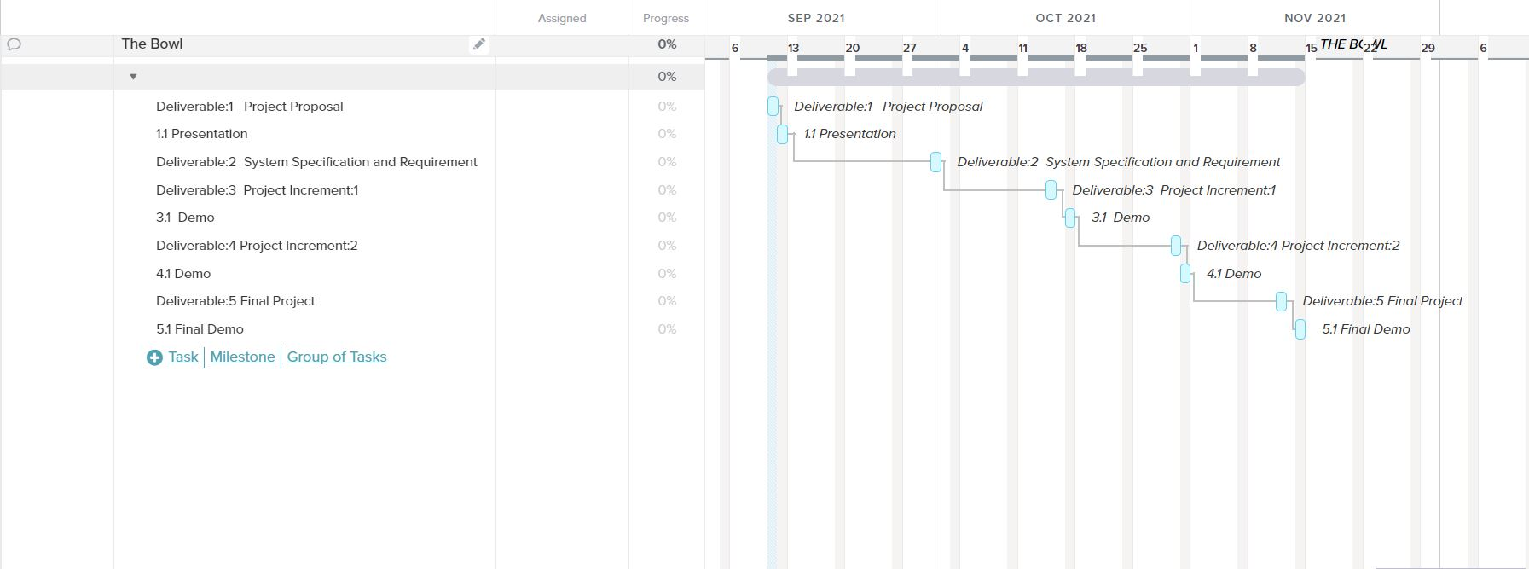
Gantt chart:

Slide 9
Limitations and Challenges:
Hosting the application.
Payment
Orders functionalty

Slide 10
Thank You

